Slide 1
Object tracking in Python
by Stephen Cross
12th December 2019
IAFIG-RMS - Bioimage Analysis With Python
Cambridge Bioinformatics Training Centre
Introduction to ImageJ
Part I: Basic Image handling
2012
Graeme Ball

Slide 2
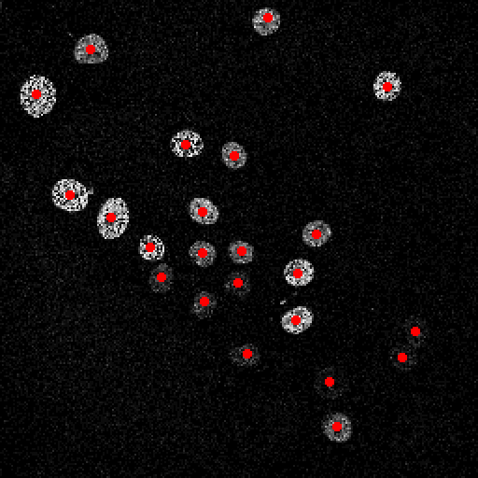
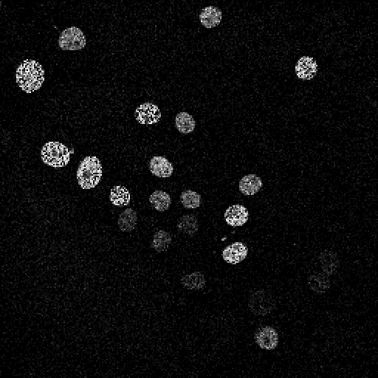
Introduction
Data from
"Recruitment of Oct4 Protein to UV-Damaged Chromatin in Embryonic Stem Cells“
Bártová, E., Šustáčková, G., Stixová, L., Kozubek, S., Legartová, S. & Foltánková, V.
(2011) PLOS ONE
Aim - Take pre-detected object coordinates and track them through multiple frames

Slide 3
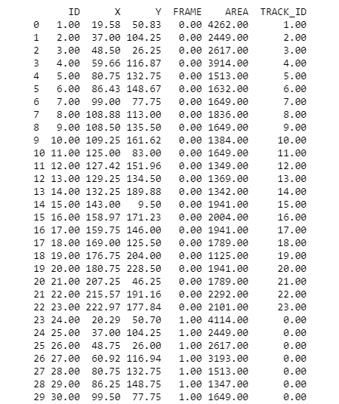
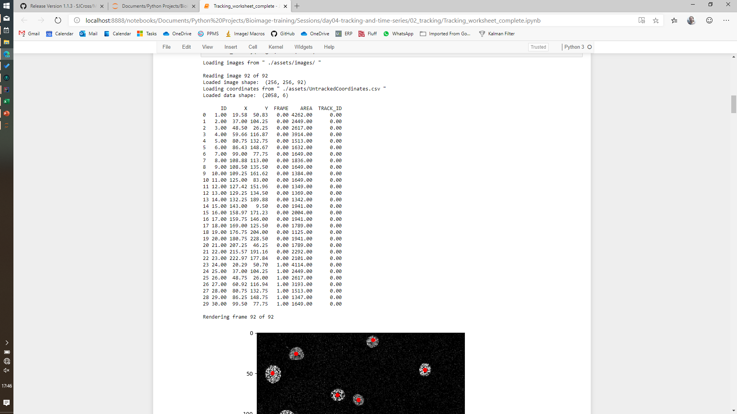
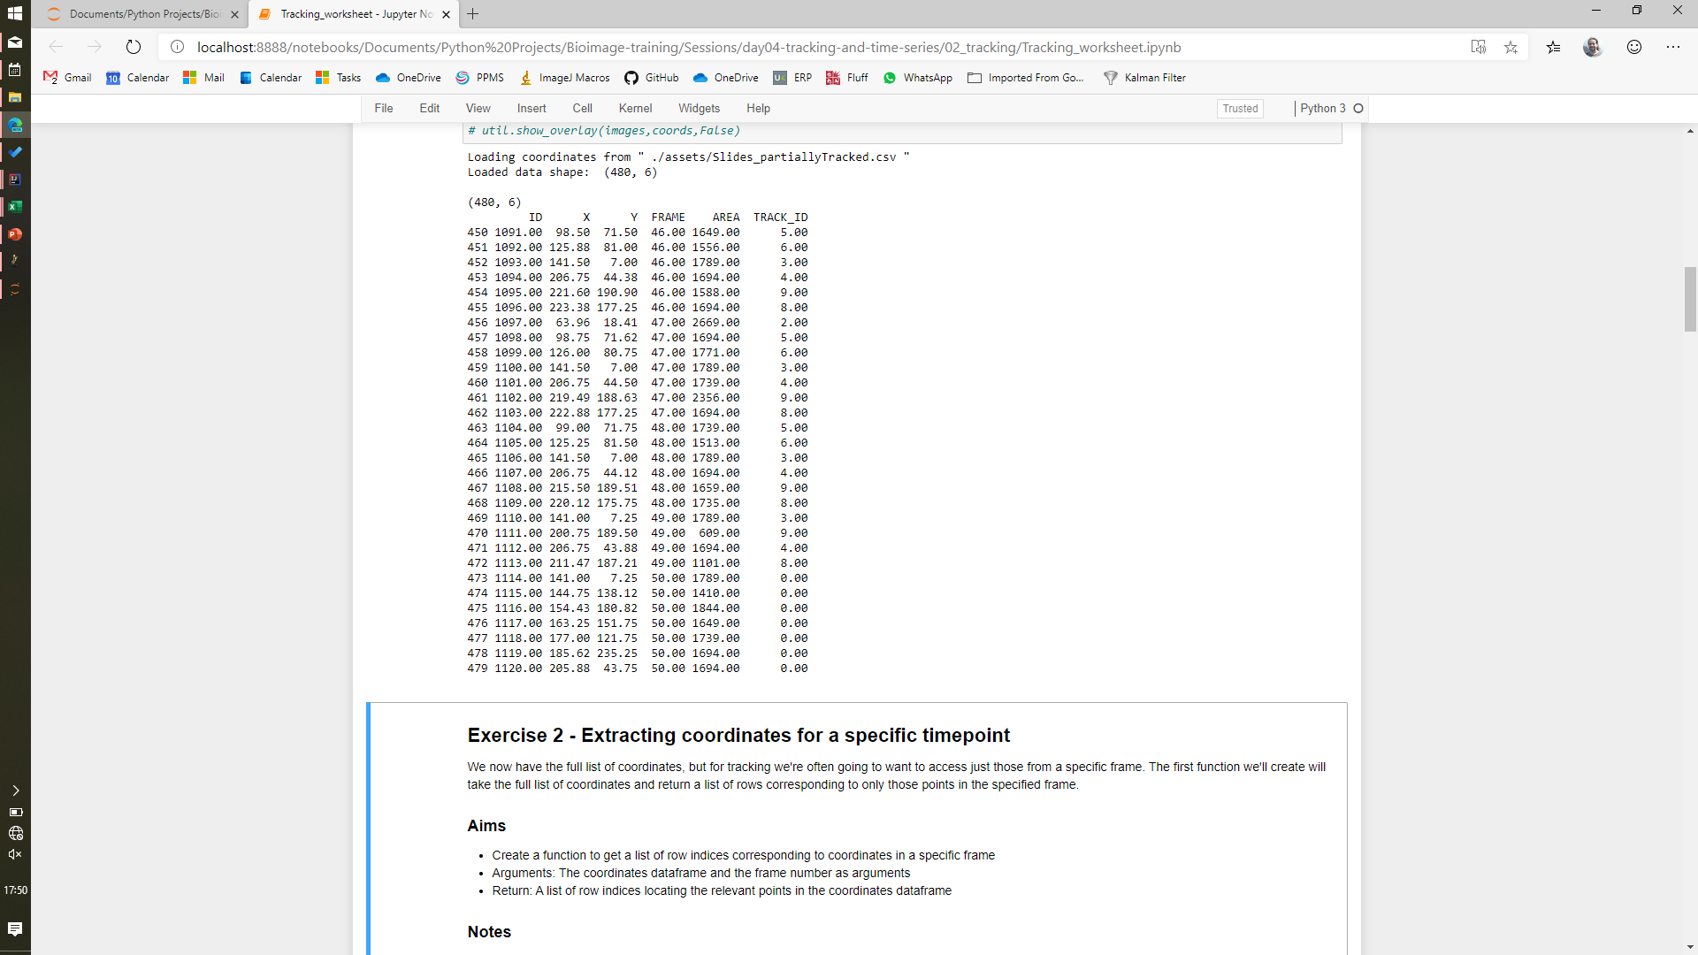

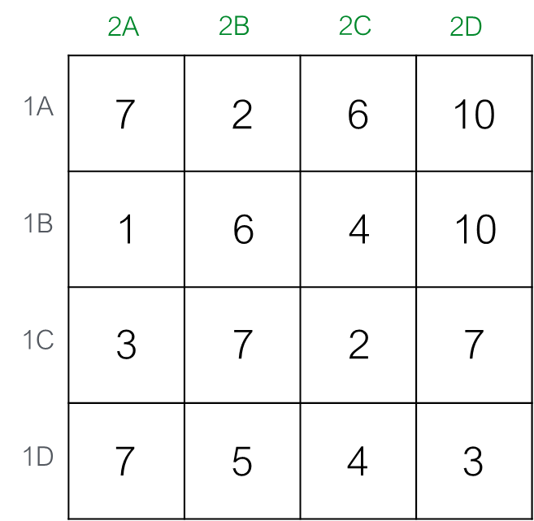
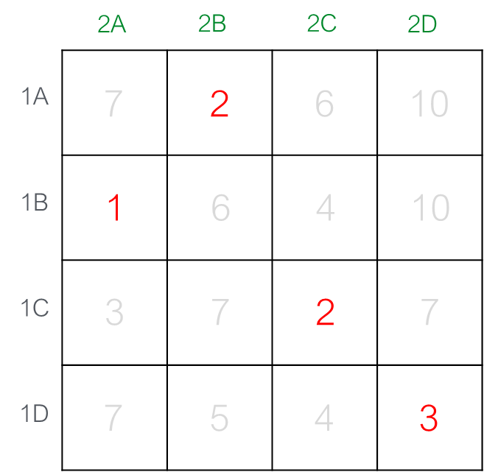
Introduction
Import coordinates
2A
1A
2A
1A
1B
1B
Initialise tracks
2B
2B
1C
1C
2C
More frames to process?
2C
Yes
1D
1D
Identify available tracks
2D
2D
Identify current points
Calculate linking costs
No
Calculate optimal assignments
Points inherit track IDs
Visualise / output tracks

Slide 4
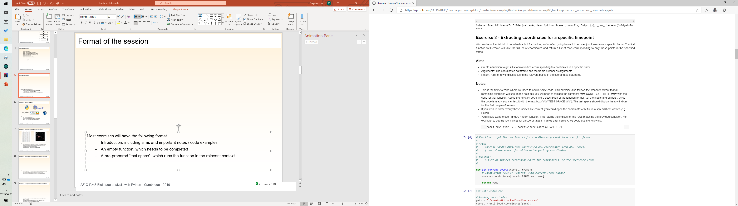
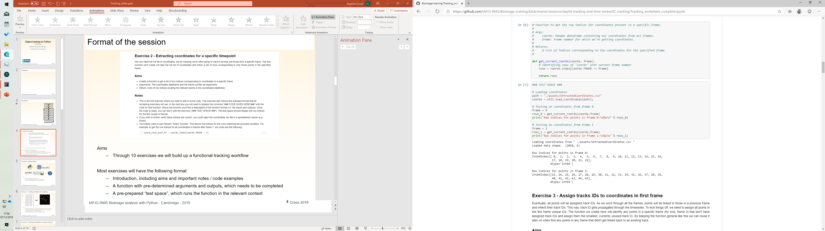
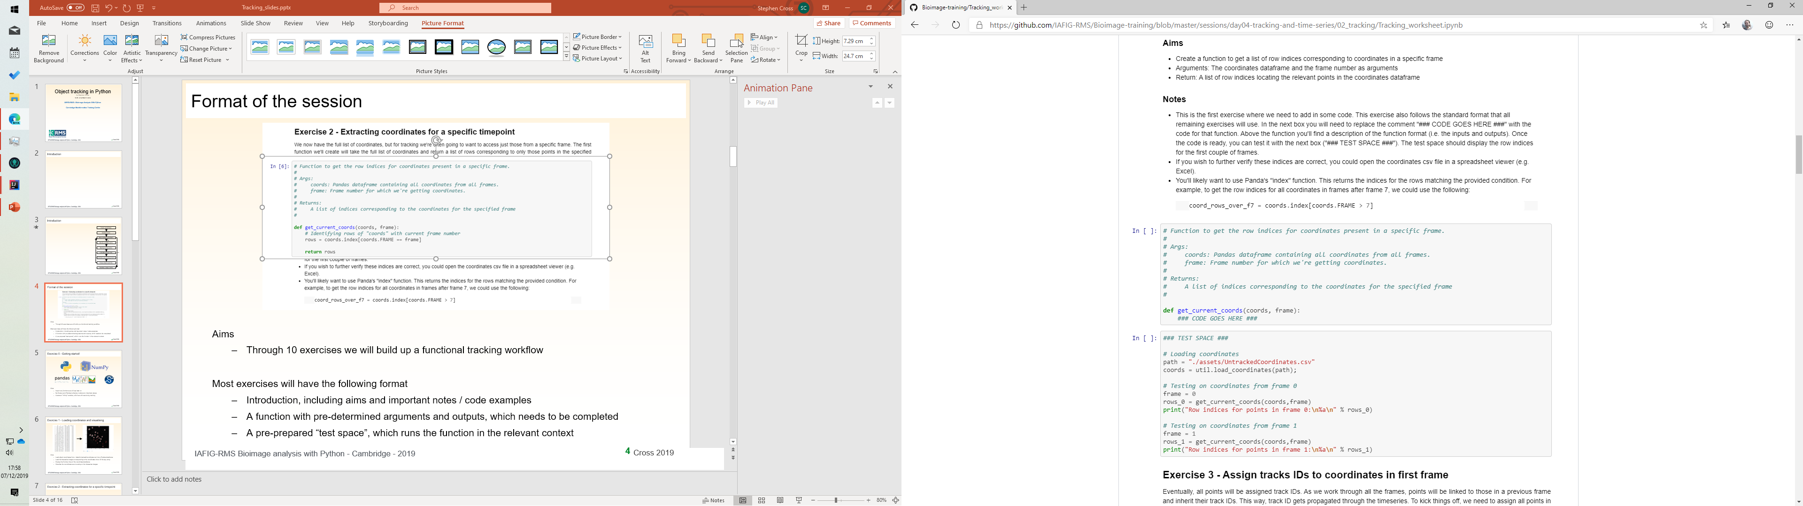
Format of the session
Aims
Through 10 exercises we will build up a functional tracking workflow
Most exercises will have the following format
Introduction, including aims and important notes / code examples
A function with pre-determined arguments and outputs, which needs to be completed
A pre-prepared “test space”, which runs the function in the relevant context

Slide 5


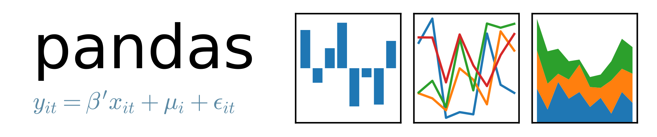

Exercise 0 - Getting started
Aims
Import any functions we will use later on
Set Numpy and Pandas to display numbers to 2 decimal places
Create an "infinity" variable, which we will use during tracking

Slide 6
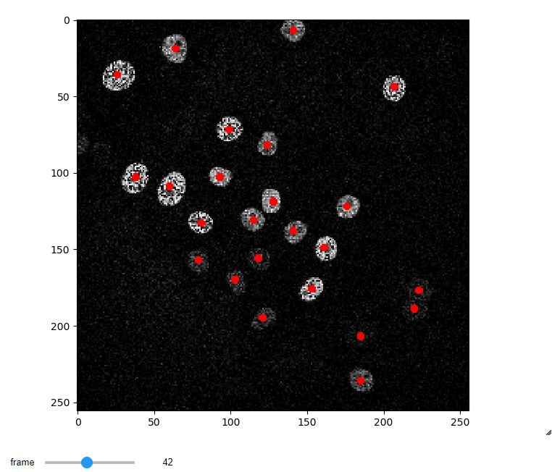
Exercise 1 - Loading coordinates and visualising
Aims
Load object coordinates from ../data/UntrackedCoordinates.csv into a Pandas dataframe
Load the timeseries images corresponding to the coordinates into a 3D Numpy array
Display the first few lines of the coordinate dataframe
Visualise the coordinates as an overlay on the timeseries images

Slide 7
Exercise 2 - Extracting coordinates for a specific timepoint
Row indices for coordinates in frame 0
Aims
Create a function to get a list of row indices corresponding to coordinates in a specific frame
Arguments: The coordinates dataframe and the frame number as arguments
Return: A list of row indices locating the relevant points in the coordinates dataframe

Slide 8
Exercise 3 - Assign tracks IDs to coordinates in first frame
Aims
Assign unique track ID numbers to the rows in the coordinates dataframe ("coords") that match the provided rows
Arguments: The coordinates dataframe and the row indices to assign track IDs for
Return: Nothing! This function will update the input dataframe

Slide 9
Exercise 4a - Getting all tracks
Identify unique track IDs
2,3,4,5,6,8,9
Get last instance of each track
Get row indices for each
456,463,464,469,470,471,472
Aims
Get a list containing the row indices of the most recent coordinate for each track
Arguments: The coordinates dataframe
Return: A list of row indices for the most recent instance of each track

Slide 10
Exercise 4b - Getting all RECENT tracks
Identify unique track IDs
2,3,4,5,6,8,9
Get last instance of each track
Remove tracks outside f range
(e.g. 2 frames prior)
Get row indices for each
463,464,469,470,471,472
Aims
Repeat the code from Exercise 4a, but only permit links to tracks between the provided values of *start_frame* and *end_frame*
Arguments: The coordinates dataframe, the start and end frames, between which we will get available tracks
Return: A list of row indices for the most recent instance of each track

Slide 11
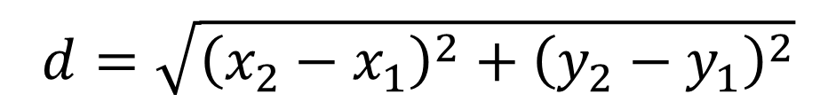
Exercise 5 - Calculating cost for linking two points
2A
2B
2C
2D
1A
2A
2A
1A
1A
7
2
6
10
1B
2B
2B
2B
(x₁, y₁)
1
6
4
10
1C
1B
2C
2C
d
$$d=\sqrt{{\left(x_{2}−x_{1}\right)}^{2}+{\left(y_{2}−y_{1}\right)}^{2}}$$
1D
1C
3
7
2
7
2D
(x₂, y₂)
2D
1D
7
5
4
3
Frame 1
Frame 2
Cost matrix
Aims
Calculate the cost for linking two provided coordinates
Arguments: The coordinates dataframe, the row index for last instance of the track, row index for current point, a distance threshold
Return: A single, floating point value corresponding to the cost for linking these two points

Slide 12
Exercise 6 - Calculate cost matrix
2A
2B
2C
2D
1A
2A
1A
7
2
6
10
1B
2B
1C
1B
1
6
4
10
2C
1D
1C
3
7
2
7
2D
1D
7
5
4
3
Frame 1
Frame 2
Cost matrix
Aims
Given two lists containing row indices, the first for the most recent instance of all available tracks and the second for all points in the current frame, calculate a cost matrix.
Arguments: The coordinates dataframe, the row indices for tracks, row indices for current points, a distance threshold
Return: An array of floating point values corresponding to the costs for linking all points

Slide 13
Exercise 7 - Assigning tracks
2A
2B
2C
2D
Track
Point
1A
7
2
6
10
1
0
1B
1
6
4
10
0
1
1C
3
7
2
7
2
2
1D
7
5
4
3
3
3
Cost matrix
Assignments
Aims
Using the calculated track-point assignments, apply the relevant track IDs to each point.
Arguments: The coordinates dataframe, the row indices for the tracks and points to be (potentially) linked, the cost matrix for these tracks and points.
Return: Nothing! This function will update the input dataframe

Slide 14
Exercise 8 - Putting it all together
Import coordinates
Initialise tracks
More frames to process?
Yes
Identify available tracks
Identify current points
Calculate linking costs
No
Aims
Take the various functions you've created over the past few exercises and put them all together, so we can track over all frames.
At the end of this section you want to end up with the TRACK_ID column of the coords dataframe completed (i.e. all rows have a relevant ID).
Calculate optimal assignments
Points inherit track IDs
Visualise / output tracks

Slide 15




A few links
www.bristol.ac.uk/wolfson-bioimaging
www.github.com/sjcross
www.github.com/IAFIG-RMS
stephen.cross@bristol.ac.uk
www.rms.org.uk

